Slide 1
COSMIC Functional Size Automation of Java Web
Applications Using the Spring MVC Framework

Slide 2
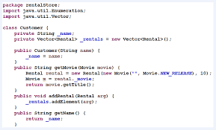
Technical project
+
=
COSMIC
CFP Automatically
Java Code Source
Introduction
1
Notes:
This technical project is part of the master's degree in software engineering at the University of Quebec in Montreal (UQAM).
Realize the basis of a project open source for automated functional size measurement using the COSMIC from code source of a Java web application using the Spring Web MVC framework

Slide 3
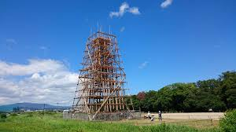
Using Related works
No trace of the related works
2
Notes:
The fist idea was to implement a SonarQube plugin that display the CFP of a project on the dashboard.
we assumed that there is some work already done that we can use as a basis for the implementation of the plugin
We were not able to find trace of these tools while searching on popular open-source repositories

Slide 4
CFP4J
Java Library
Publish
Brainstorming Sessions
Project of 6 credits
Definition of our project
3
Notes:
The final idea was to develop a Java library to automate COSMIC FSM for Java applications.
Based on these sizing automation publications, we wanted to contribute to COSMIC FSM automation by targeting a technology in which sizing was not yet automated. Also we had a time constraint as this technical project is a master’s degree capstone project (6 credits) which is a shot time to develop a Java library for all Java technologies.
So the scope of the project was as the following:
Java version 5 or higher;
Web applications using Spring Web MVC framework, version 5.x.x or above, since this framework is the most popular forJava Web applications*;
for data access, the library Spring Data is used.

Slide 5
Source Code
MR01
Any OoI found among the input parameters of the method with one of the annotations @PostMapping, @GetMapping, @RequestMapping or @ModelAttribute is considered an Entry data movement.
Mapping Phase
12 defined mapping rules
Data Movement
Data Group
Java Code snippet
Measurement Phase
Functional sizing CFP
Example of a mapping rule
Mapping Rules
4

Slide 6
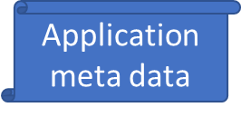
CFP4J Project
cfp4j-application
Configuration file
Application to measure
cfp4j-application
CFP4J Library
cfp4j-springMVC
cfp4j-application
cfp4j-core
cfp4j Library
CFP
CFP4J Project
5
Notes:
Offer a reusable and modular solution (a library) that could be integrated with almost any source code analysis tool → A JAR file is available and can be integrated
as a dependence of an application source code.
CFP4J-Application is a sample module used to test the CFP4J library integration
Using CFP4J on a new software requires approximately 10 minutes to download locally the software code and adjusting the Configuration file accordingly.
The execution itself for sizing takes only few seconds, after which both Excel and Json files are created.

Slide 7
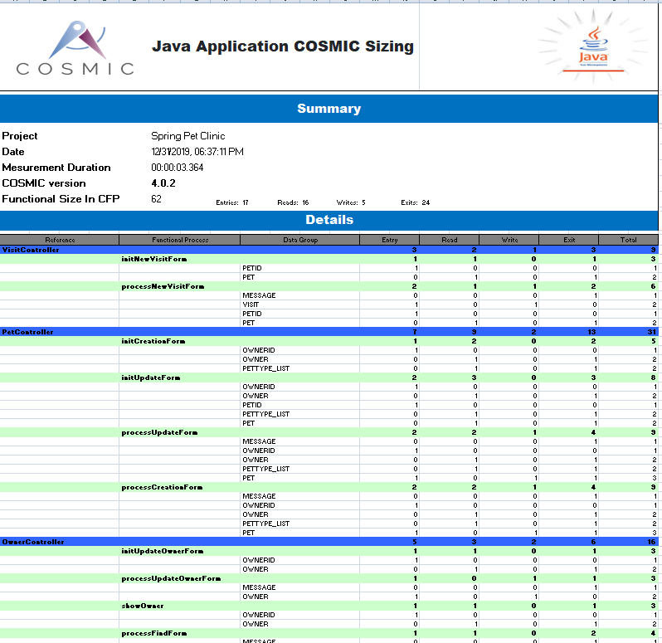
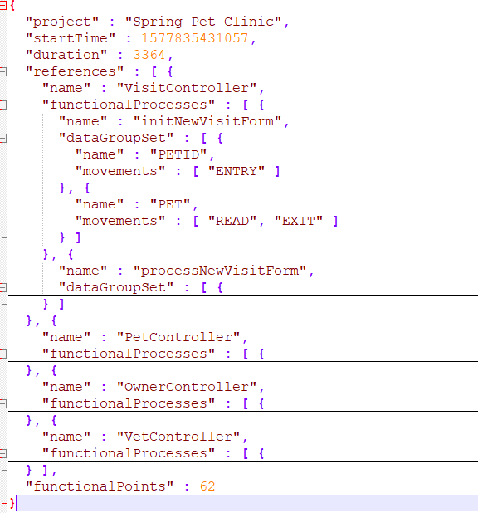
CFP4J Project
6

Slide 8
Manual sizing = 17 CFP => CFP4J sizing = 16 CFP
Manual sizing = 56 CFP => CFP4J sizing = 62 CFP
Manual sizing = 172 CFP => CFP4J sizing = 173 CFP
The average accuracy is satisfactory (=97.6%> goal > 90%)
CFP4J Accuracy vs Manual sizing
7
Notes:
Differences were investigated: manual sizing differences were due to incompleteness or ambiguous measurement inputs

Slide 9
You'll need
Follow the instruction on the page:
https://gitlab.com/asahab/cfp4j
Using CFP4J
8

Slide 10
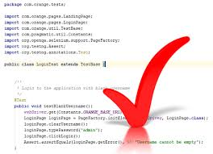
CFP4J supports limited technologies
CFP4J require the JAVA common coding conventions/guideline which developers should conform to
CFP4J Limitations
9

Slide 11
CFP4J
Future Work
10
Notes:
1- Support the JAVA standard by Integrating the JDBC library and the JAVA EE JPA in the CFP4J-core module. It will help us to extract the READ/WRITE data movements from the projects using those technologies
2- Add the support of the Spring JDBC to expend the CFP4J-SpringMVC
3- Deploy the CFP4J project on the Maven repository
4- Implement new CFP4 module to support other JAVA MVC frameworks like Apache Struts and Java Server Faces JSF

Slide 12
CFP4J Future Work
11

Slide 13
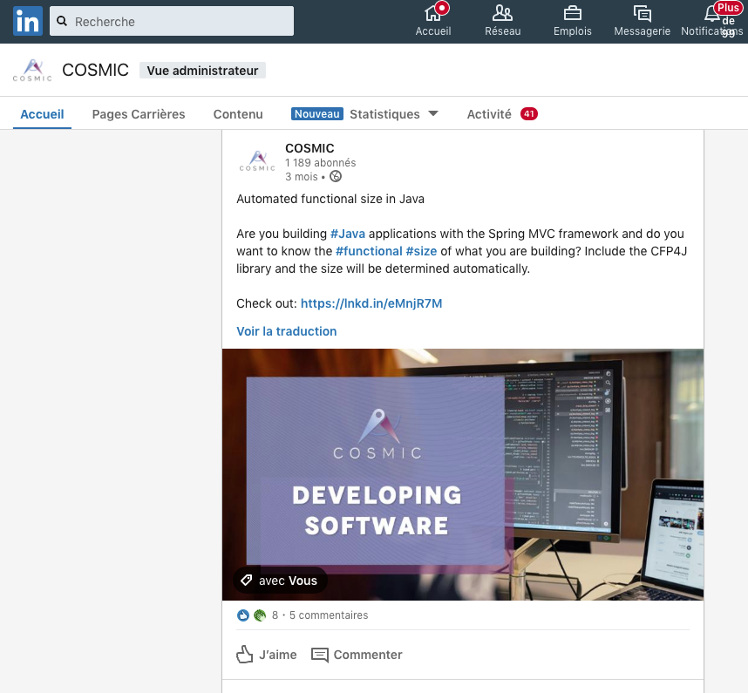
Prologue to IWSM/CNMES 2020:
Invitation to the community to contribute at expanding CFP4J
Please visit https://gitlab.com/asahab/cfp4j
12
Notes:
Our paper was submitted for review to the EasyChair.org website on July 10th.
Few days later, on July 19th our tool was announced on LinkedIn.

