Slide 1
Meta-models for Software Quality and Its Evaluation: A Systematic Literature Review
Nebi Yılmaz and Ayça Kolukısa Tarhan
Software Engineering Research Group (HUSE),
Hacettepe University Computer Engineering Department, Ankara, Turkey {yilmaz, atarhan}@cs.hacettepe.edu.tr

Slide 2
Content
Introduction
Related Work
Research Method
Results
Threats to Validity
Conclusion
Future Works
List of Primary Studies
References

Slide 3
Introduction
Software Quality
Challenging task to define software quality in the field of software engineering.
  IEEE [1] defines it as “the degree to which a system, component, or process meets customer or user needs or expectations”.
  ISO 9001 standard [2], by contrast, defines it as “the totality of characteristics of an entity that bear on its ability to satisfy stated and implied needs”.
Poor quality of software lead to loss of human life, permanent injury, mission failure, dissatisfaction of the users, increase in the cost of maintenance and financial loss [3].

Slide 4
Introduction
Quality Models
Well-defined quality models
  E.g: Boehm [4], McCall [5], ISO 9126 [6], ISO 25000 SQuaRE series [7]
Shortcoming of Quality Models;
  Do not cover the entire life cycle of software [8][9][10]
  Do not have a clear vision to explain the correlation between metrics and criteria [8][9][10].
  Cover all aspects of software quality but metrics are not consistent with their own conceptual definitions [8][9][10].
  They are stated to provide either abstract quality attributes or concrete quality assessments. There are no models that seamlessly integrate both aspects [8][9][10].
  Combining these isolated models and heterogeneous results of code analysis tools to achieve a more complete picture of software quality becomes a main challenge [9][11].

Slide 5
Introduction
Meta-models
Researchers have proposed meta-models based on existing quality models [10][12].
There seems a need to represent the concepts of software quality and evaluation more formally, and meta-models can be a suitable vehicle to do this.
Meta-models are expected to combine the isolated views to achieve a more complete picture of software quality and in turn, to create a common understanding between stakeholders for proper quality management throughout the entire life of a software product.

Slide 6
Introduction
Purpose of this Study
In order to examine comprehensively the content and structure of the meta-models proposed for software quality and its evaluation (SQiE) in scientific literature, a Systematic Literature Review (SLR) [13] study was carried out.
An SLR helps to evaluate and interpret available research relevant to a particular research hypothesis, topic area, or phenomenon of interest.
In this regard, the most-known academic search engines were used and only 28 studies out of 114 initially selected.
While conducting this study, the PICO template (Population, Intervention, Comparison, Outcomes) which was proposed by [13] is followed.

Slide 7
Related Work
Study | Type of study | What has been investgated?
 |  | Quality Models | Meta-models
Nistala et al. [14] | Systematic Mapping | Yes | Partly
Tomar et. al. [15] | Systematic Mapping | Yes | No
Yan et al. [16] | Systematic Mapping | Yes | No
Cote et al.[17] | Comparison | Yes (compare only 4 quality models) | No
Miguel et al. [18] | Review | Yes | No
To the best of our knowledge, this is the first SLR study conducted on the meta-models for SQiE.

Slide 8
Research Method
Process steps used in SLR

Slide 9
Research Method
Research Questions of SLR
RQ# | Description
RQ.1 | What are the basic characteristics of the meta-model proposed in the study?
RQ.1.1 | What is the main purpose of the meta-model proposed? (e.g. generic or specific)
RQ.1.2 | Which type of software products are targeted for SQiE? (e.g. OSS, COTS, custom)
RQ.1.3 | Is the meta-model taken as the base for tool development in the study? (yes or no)
RQ.2 | Are there any software quality models taken as reference for the proposal? If yes:
RQ.2.1 | Which software quality model(s) are taken as reference? (e.g. ISO 25000)
RQ.2.2 | Does the meta-model serve for SQiE with respect to all the models taken as reference?
RQ.2.3 | Is the terminology of the software quality model(s) taken as reference mapped to the terminology defined by the meta-model in the study?
RQ.2.4 | Is the structure of the software quality model(s) taken as reference mapped to the structure of the meta-model in the study?
RQ.3 | What are the basic characteristics of SQiE as defined in the meta-model?
RQ.3.1 | What methods/techniques are used as reference for SQiE? (e.g. GQM)
RQ.3.2 | Does the meta-model support qualitative or quantitative evaluation?
RQ.3.3 | Does the meta-model support subjective or objective evaluation?
RQ.3.4 | Does the meta-model support SQiE at a single point or throughout software evolution?
RQ.3.5 | How are the results of evaluation provided to users? (e.g. single index, table, graphic)
RQ.3.6 | Which data analytics methods are defined for SQiE in the meta-model? (e.g. statistical, ML, expert evaluation, fuzzy)
RQ.3.7 | Does the meta-model support SQiE in a specific phase in software development? If yes, which phase is it? (e.g. requirements, coding, field-use)

Slide 10
Research Method
Research Questions of SLR (cont.)
1. Introduction
RQ# | Description
RQ.4 | How is the meta-model structured?
RQ.4.1 | Is there a specific structure of the meta-model? If yes, what is it? (e.g. hierarchical)
RQ.4.2 | Is the meta-model structured to define/include new quality models in evaluation?
RQ.4.3 | What are the entities defined in the meta-model?
RQ.5 | What are the means of data acquisition as defined in the meta-model? (e.g. manual entry, batch import, automatic transfer from other repositories)
RQ.6 | Has the meta-model been validated? If yes, what was the method of validation? (e.g. case study, literature mapping, peer review)
RQ.7 | How was the meta-model developed?
RQ.7.1 | Was there a research method employed for development? If yes, what was it?
RQ.7.2 | What were the challenges faced in developing the meta-model?

Slide 11
  Research Method
  Search string
("Meta model" OR "Meta-model") AND ("software quality") AND ("evaluation" OR "assessment" OR "measurement")
Digital Library | URL | Number of publications
ScienceDirect | www.sciencedirect.com | 216
IEEE Xplore | ieeexplore.ieee.org | 19
SCOPUS | www.scopus.com | 50
Google Scholar | scholar.google.com | 5.670
ACM Digital Library | dl.acm.org | 152
Web of Science | apps.webofknowledge.com | 7
Springer | www.springer.com | 374
TOTAL |  | 6.488

Slide 12
  Research Method
  Publication selection
Exclusion criteria:
  Duplicate articles
  Articles that are not in English
  Not formally reviewed articles such as tutorials, sessions, workshop, keynotes, corrigendum and panel
  Books and thesis
  Articles that do not cover the meta-model for SQiE.
Inclusion criteria:
  Studies are concerned with SQiE
  Studies propose meta-models (or abstract the concepts of SQiE)
  Studies provide mature enough formal representations of the meta-models.

Slide 13
  Research Method
  Publication selection and Data extraction
Publication selection;
  Both authors assigned numbers to the articles as ‘0’ or ‘1’, independently.
  By reviewing title, abstract and keywords→114 studies were selected
  By reviewing full text→ 24 of 114 studies were selected
  By applying backward and forward snowballing [19] → 4 more articles were included.
  As a result, a total of 28 publications were selected for detailed analysis.
Data extraction;
  The first author answered the RQs by reading the full texts.
  Then, peer-review was performed by the second author and any conflict between the authors was resolved in a series of discussions.
  Data extraction sheet can be reached by the following link: https://tinyurl.com/ybz2ybky

Slide 14
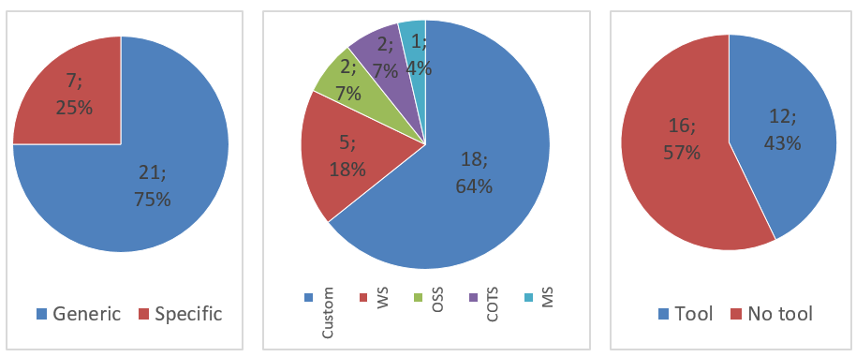
Results
RQ1: What are the basic characteristics of the meta-model proposed in the study?
RQ1.1: What is the main purpose of the meta-model proposed?
RQ1.2: Which type of software products are targeted for SQiE?
RQ1.3: Is the meta-model taken as the base for tool development in the study?

Slide 15
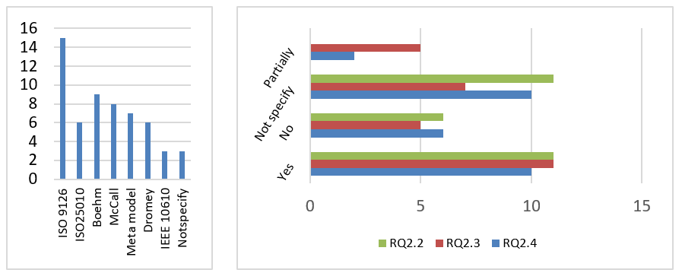
Results
RQ2: Are there any software quality models taken as reference for the proposal? If yes;
RQ2.2: Does the meta-model serve for SQiE with respect to all the models taken as reference?
RQ2.3: Is the terminology of the software quality model(s) taken as reference mapped to the terminology defined by the meta-model in the study?
RQ2.4: Is the structure of the software quality model(s) taken as reference mapped to the structure of the meta-model in the study?
RQ2.1: Which software quality model(s) are taken as reference?

Slide 16
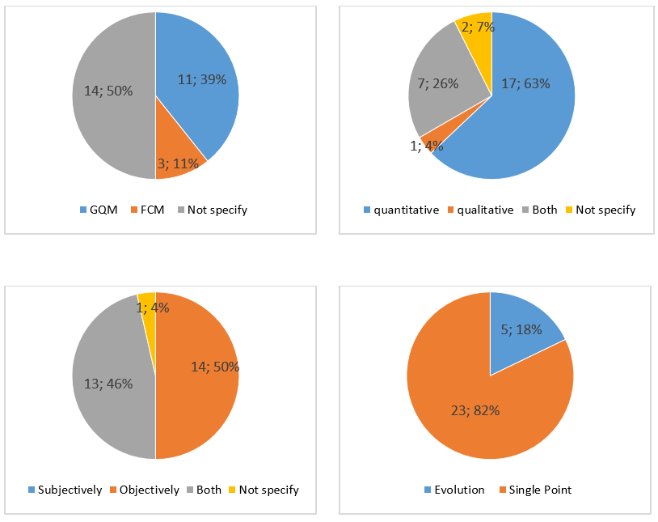
Results
RQ3: What are the basic characteristics of SQiE as defined in the meta-model?
RQ3.1: What methods/techniques are used as reference for SQiE?
RQ3.2: Does the meta-model support qualitative or quantitative evaluation?
RQ3.3: Does the meta-model support subjective or objective evaluation?
RQ3.4: Does the meta-model support SQiE at a single point or throughout software evolution?

Slide 17
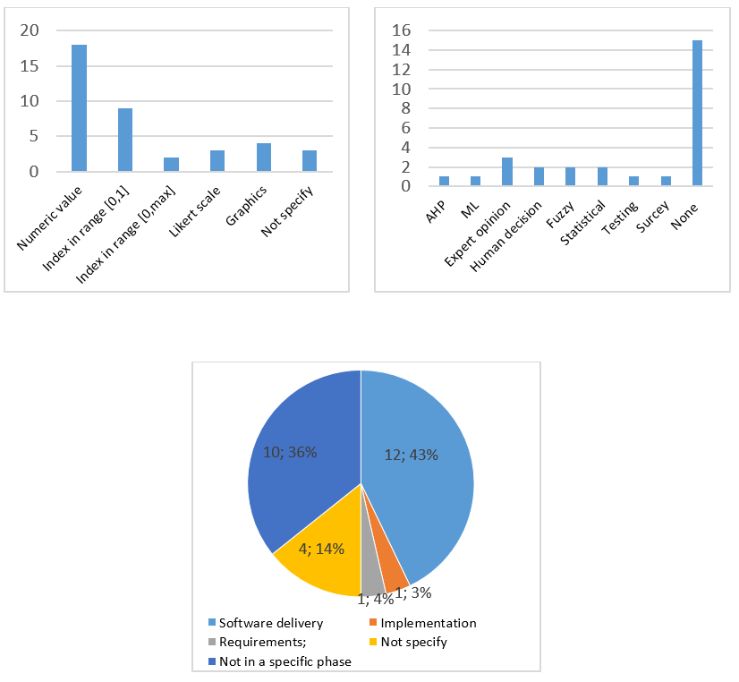
Results
RQ3: What are the basic characteristics of SQiE as defined in the meta-model?
RQ3.5: How are the results of evaluation provided to users?
RQ3.6: Which data analytics methods are defined for SQiE in the meta-model?
RQ3.7: Does the meta-model support SQiE in a specific phase in software development? If yes, which phase is it?

Slide 18
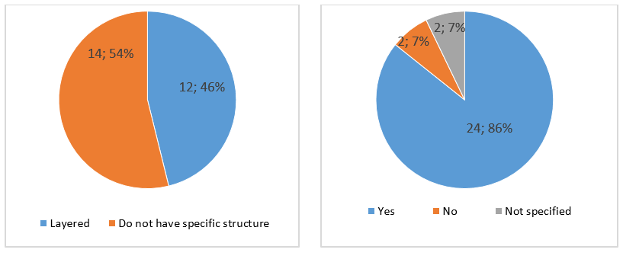
Results
RQ4: How is the meta-model structured?
RQ4.1: How is the meta-model structured?
RQ4.2: Is the meta-model structured to define/include new quality models in evaluation?

Slide 19
Results
RQ4: How is the meta-model structured?
Category | Names of entities in different meta-models | #Freq.
Data analysis | Syn: Analysis model / decision criteria / interpretation rule / analysis | 7
Entity | Syn: Entity / component / quality artifact / measurable entity | 18
Evaluation (E) | Syn: Evaluation / assessment model Agg: Formula / rule / E. result / E. aspect / E. impact | 14
Instrument | Syn: Tool / instrument | 5
Measure | Syn: Measure / metric Agg: Base measure / base metric / derived measure / derived metric | 23
Measurement (M) | Agg: M. approach / measurable concept / M. method / M. function / M. data / M. result / value / indicator | 13
Property | Syn: Property / quality aspect / quality dimension / quality type / feature | 12
Quality attribute | Syn: Quality characteristic / quality attribute / quality factor / characteristic / attribute / factor / product factor Agg: Sub-characteristic / sub-factor / base attribute / direct attribute / derived attribute / indirect attribute | 27
Quality goal | Syn: Quality goal / goal / quality target / purpose / target / objective | 7
Quality model | Syn: Quality model | 9
Requirement | Syn: Quality requirement / requirement / specification | 3
Scale | Syn: Scale / type of scale / measurement scale | 4
Unit | Syn: Unit / measurement unit / unit of measurement | 7
View | Syn: Viewpoint / view / stakeholder | 6
* Syn denotes synonymous concepts for a category, while Agg denotes sub-categories or aggregated concepts under a category.
RQ4.3: What are the entities defined in the meta-model?

Slide 20
Results
RQ5 & RQ6
RQ.5: What are the means of data acquisition as defined in the meta-model?
RQ.6: Has the meta-model been validated? If yes, what was the method of validation?

Slide 21
Results
RQ7: How was the meta-model developed?
RQ7.1:Was there a research method employed for development? If yes, what was it?

Slide 22
Results
RQ4: How was the meta-model developed?
Description of challenge | #study
C1: Inconsistency in terminology: Most approaches that are not based on theoretical grounds, lack a definition for quality concepts that is precise and concise [20]. | 9 (24%)
C2: Partially defined: Most quality models are outlined but not fully developed. All define measurable concepts, some of them also attributes, few of them include (most often partial) measures and scarcely any defines decision criteria or indicators [20]. | 7 (18%)
C3: Lack of focus: Most quality models provide an extensive (and mostly tangled) coverage of stakeholders and levels of abstraction [20]. | 7 (18%)
C4: Lack of clarity in interdependencies and measure interpretations: In most quality models that are not based on theory, the degree of influence of individual internal quality factors on the quality in use of the application, as well as their interdependencies, are not well established [20]. Also, measure interpretations of some models are not clear. | 11(30%)
C5: Different expectations of stakeholders: Stakeholders in the software process has different expectations from meta-models | 4 (10%)
RQ7.2: What were the challenges faced in developing the meta-model?

Slide 23
Threats to Validity
There may be threats to validity in some issues;
  Selection of search string
  Researcher bias in identifying the exclusion/inclusion criteria
  Threat of data extraction
  Inconsistency in the schemes of classification (E.g in RQ 7.1)

Slide 24
Conclusion
Results of an SLR study are reported in order to examine comprehensively the content and structure of the 28 meta-models proposed for SQiE in scientific literature.
The most-known seven digital libraries were searched, and 28 studies out of 114 initially selected and 6488 initially retrieved were identified.
These primary studies were analyzed with respect to seven research questions.
To the best of our knowledge, this is the first SLR study conducted on the meta-models for SQiE.
This SLR study might help researchers and practitioners in understanding the state of the art on the meta-models proposed for SQiE.

Slide 25
Future Work
The set of 28 studies in the pool serves as a reference catalogue for researchers, and the detailed analysis provides a kind of guide in seeing the weak aspects to propose further meta-models or design further studies.
The studies that propose tools based on the meta-models, on the other hand, might be useful for practitioners for investigation and adoption for their use.

Slide 26
List of Primary Studies
1 | Kitchenham, Barbara, et al. "The SQUID approach to defining a quality model." Software Quality Journal 6.3 (1997): 211-233.
2 | Burgués Illa, Xavier, Javier Franch Gutiérrez, and Josep M. Ribó. "A MOF-compliant approach to software quality modeling." (2004).
3 | Sack, PM Oum Oum, et al. "On building an integrated and generic platform for software quality evaluation." 2006 2nd International Conference on Information & Communication Technologies. Vol. 2. IEEE, 2006.
4 | Dubielewicz, Iwona, et al. "Software quality meta-model for requirement, evaluation and assessment." ISIM06 Conference, vol. No. 105. 2006.
5 | Casola, Valentina, et al. "A policy-based evaluation framework for Quality and Security in Service Oriented Architectures." IEEE International Conference on Web Services (ICWS 2007). IEEE, 2007.
6 | Deissenboeck, Florian, et al. "An activity-based quality model for maintainability." 2007 IEEE International Conference on Software Maintenance. IEEE, 2007.
7 | Garcia, Félix, et al. "Managing software process measurement: A meta-model-based approach." Information Sciences 177.12 (2007)
8 | Cachero, Cristina, Coral Calero, and Geert Poels. "Metamodeling the quality of the web development process’ intermediate artifacts." International Conference on Web Engineering. Springer, Berlin, Heidelberg, 2007.
9 | Mohagheghi, Parastoo, and Vegard Dehlen. "A meta-model for specifying quality models in model-driven engineering." Proceedings of the Nordic Workshop on Model Driven Engineering. 2008.
10 | Casola, Valentina, et al. "An ahp-based framework for quality and security evaluation." 2009 International Conference on Computational Science and Engineering. Vol. 3. IEEE, 2009.
11 | Domínguez-Mayo, F. J., et al. "A quality model in a quality evaluation framework for mdwe methodologies." 2010 Fourth International Conference on Research Challenges in Information Science (RCIS). IEEE, 2010.
12 | Luckey, Markus, et al. "Reusing security requirements using an extended quality model." Proceedings of the 2010 ICSE Workshop on Software Engineering for Secure Systems. 2010.
13 | Goeb, Andreas, and Klaus Lochmann. "A software quality model for SOA." Proceedings of the 8th international workshop on Software quality. 2011.
14 | Lochmann, Klaus, and Andreas Goeb. "A unifying model for software quality." Proceedings of the 8th international workshop on Software quality. 2011.

Slide 27
List of Primary Studies
15 | Klas, Michael, Constanza Lampasona, and Jurgen Munch. "Adapting software quality mod-els: Practical challenges, approach, and first empirical results." Euromicro Conference on Software Engineering and Advanced Applications. 2011.
16 | Mens, Tom, et al. "Qualgen: Modeling and analysing the quality of evolving software sys-tems." 2011 15th European Conference on Software Maintenance and Reengineering. IEEE, 2011.
17 | Vanderose, Benoit, and Naji Habra. "Tool-support for a model-centric quality assessment: QuaTALOG." Joint Conference of the 21st International Workshop on Software Measurement, IEEE, 2011.
18 | Wagner, Stefan, et al. "The Quamoco product quality modelling and assessment approach." 2012 34th International Conference on Software Engineering (ICSE). IEEE, 2012.
19 | Goeb, Andreas. "A Meta Model for Software Architecture Conformance and Quality Assessment." Electronic Communications of the EASST 60 (2013).
20 | Boukouchi, Youness, et al. "A MetaModel for Quality Software Based on the MDA Ap-proach."
21 | Trendowicz, Adam, et al. "Model-based product quality evaluation with multi-criteria decision analysis." (2014).
22 | Boukouchi, Youness, et al. "QMGenerator: Generation of quality models from a metamodel based on The MDA approach." 2014 International Conference on Next Generation Networks and Services (NGNS). IEEE, 2014.
23 | Doneva, Rositsa, et al. "Software Quality Assessment Tool Based on Meta-Models." (2015).
24 | Khammal, Adil, et al. "General Meta Model of Software Quality." vol 7 (2016): 7.
25 | Wagner, Stefan, et al. "Operationalised product quality models and assessment: The Quamoco approach." Information and Software Technology 62 (2015): 101-123.
26 | Cardarelli, Mario, et al. "An extensible data-driven approach for evaluating the quality of microservice architectures." Proceedings of the 34th ACM/SIGAPP Symposium on Applied Computing. 2019.
27 | Haindl, Philipp, Reinhold Plösch, and Christian Körner. "An Extension of the QUAMOCO Quality Model to Specify and Evaluate Feature-Dependent Non-Functional Requirements." 45th Euromicro Conference, IEEE, 2019.
28 | Eghan, Ellis E., et al. "API trustworthiness: an ontological approach for software library adoption." Software Quality Journal, 2019.

Slide 28
References
IEEE Std. 610.12: Standard Glossary of Software Engineering Terminology. The Institute of Electrical and Electronics Engineers, New York, NY, USA, 1990.
ISO. ISO/IEC 14598-1: Software product evaluation - Part 1: General overview. International Organization for Standardization, Geneva, Switzerland, 1999.
Al-Qutaish, R. E.: Quality models in software engineering literature: an analytical and com-parative study. In: Journal of American Science. 6(3): 166-75, 2010.
Boehm, B. W., Brown, J. R., Lipow, M.: Quantitative evaluation of software quality. In: Pro-ceedings of the 2nd Int Conf on Software Eng, Oct 13, pp. 592-605, IEEE, 1976.
McCall, J.A., Richards, P. K., Walters, G.F.: Factors in Software Quality. Volume I. Concepts and Definitions of Software Quality, Fort Belvoir, VA: Defense Tech Info Center, 1977.
ISO/IEC TR 9126, Software engineering–Product quality – Part 1,2,3. 2002-03-15.
ISO 25000: Systems and Software Engineering—Systems and Software Quality Require-ments and Evaluation (SQuaRE) series of standards–Quality Management Division, 2014.
Thapar, S. S, Singh, P., Rani, S.: Challenges to development of standard software quality model. International Journal of Computer Applications. 49(10), 2012.
Khammal, A., Boukouchi, Y., Hanine, M., Marzak, A.: General Meta-model of Software Quality. In: (IJCSIT) International Journal of Computer Science and Information Technolo-gies, Vol. 7 (4), pp. 1728-1734, 2016.
Wagner, S., Lochmann, K., Heinemann, L., Kläs, M., Trendowicz, A., Plösch, R., Seidi, A., Goeb, A., Streit, J.: The quamoco product quality modelling and assessment approach. In: 34th International Conference on Software Engineering, pp. 1133-1142, IEEE, 2012.
Deissenboeck, F., Heinemann, L., Herrmannsdoerfer, M., Lochmann, K., Wagner, S.: The quamoco tool chain for quality modeling and assessment. In: 33rd International Conference on Software Engineering (ICSE), May 21, pp. 1007-1009, IEEE, 2011.

Slide 29
References
Boukouchi, Y., Khamal, A., Marzak, A., Moutachaouik, H. A.: MetaModel for Quality Soft-ware Based on the MDA Approach. In: International Journal of Computer Science and Infor-mation Technologies, Vol. 5 (3), pp. 4390-4393, 2014.
EBSE (2007) Guidelines for performing Systematic Literature Reviews in Software Engineering, Version 2.3, EBSE-2007-01.
Nistala, P., Nori, K. V., Reddy, R.: Software quality models: A systematic mapping study. In: IEEE/ACM International Conference on Software and System Processes (ICSSP), (pp. 125-134), IEEE, May 25( 2019)
Tomar, A. B., Thakare, V. M.: A Systematic Study Of Software Quality Models, In: International Journal of Software Engineering & Applications, vol. 2, no. 4, pp. 61–70, Oct. (2011).
Yan, M., Xia, X., Zhang, X., Xu, L., Yang, D. A.: Systematic mapping study of quality assessment models for software products. In: International Conference on Software Analysis, Testing and Evolution (SATE), (pp. 63-71), IEEE, Nov 3 (2017).
Côté, M.A., Suryn, W., Georgiadou, E.: In search for a widely applicable and accepted software quality model for software quality engineering, In: Software Quality Journal, vol. 15, no. 4, pp. 401–416, Nov. (2007).
Miguel, J. P., Mauricio, D., Rodríguez, G.: A Review of Software Quality Models for the Evaluation of Software Products, In: International Journal of Software Engineering & Applications, vol. 5, no. 6, pp. 31– 53, Nov. (2014).
Webster J, Watson R. T.: Analyzing the past to prepare for the future: writing a literature review. MIS Q 26: xiii—xxiii, (2002).
Cachero, C., Calero, C., Poels, G.: Metamodeling the quality of the web development process’ intermediate artifacts, In: International Conference on Web Engineering, (pp. 74-89). Springer, Berlin, Heidelberg, Jul 16 (2007).

Slide 30
THANK YOU

Slide 31


